Slide 1
CMS STAR-RATING & PROVIDER ANALYSIS

Slide 2
OBJECTIVE
CMS contracted to work in collaboration with other contractors to develop a methodology for the Overall Hospital Quality Star Ratings on Hospital Compare. Hospital Compare includes information on more than 100 quality measures and more than 4,000 hospitals. The primary objective of the Overall Hospital Quality Star Ratings project is to develop a statistically sound methodology for summarizing information from the existing measures on Hospital Compare in a way that is useful and easy to interpret for patients and consumers. Consistent with other CMS Star Rating programs, this methodology assigns each hospital between one and five stars, reflecting the hospital’s overall performance on selected quality measures.
Our objective is to focus on developing an approach to calculate hospital ratings and using it to identify areas of improvement for certain hospitals which also requires a thorough understanding of the rating system developed by CMS and provide recommendations for hospital to improve star ratings

Slide 3
STAGES
Data Understanding : Which involves understanding and identifying of groups and measures
Data Preparation : Involves cleaning of data(Removing duplicates ,Removing unrequited variables ,Treating missing data and null values checking for outliers .Removing crude data, Involves processing of data and analysing .Identify important measures affecting star ratings
Data Modelling : Using best models that adhere the problem statement and analyze the best supervised and unsupervised models
Provider Analytics : Using the best methodologies to improve star ratings

Slide 4
DATA UNDERSTANDING
CMS included 64 measures (or variables) classified under 7 groups having a certain weightage as follows:
Groups
• Mortality, Readmission, Safety of Care, Patient Experience (22% weightage groups)
• Timeliness of care, Effectiveness of care, Medical Imaging Efficiency (4% weightage groups).
Measures : Star Ratings are intended for acute care hospitals, CMS first omitted all measures on Hospital Compare that were specific to specialty hospitals (such as a cancer hospital or inpatient psychiatric facility), or ambulatory surgical centers prior to applying any measure selection criteria. With these measures omitted, the total number of measures eligible for inclusion in the Star Rating for October 2016 is 115 measures.

Slide 5
DATA UNDERSTANDING
Measure Selection Criteria
CMS uses the following criteria to exclude measures from the Star Rating calculation:
Measures suspended, retired, or delayed from public reporting on Hospital Compare;
Measures with no more than 100 hospitals reporting performance publicly;
Structural measures;
Measures for which it is unclear whether a higher or lower score is better (non-directional);
Measures no longer required for Inpatient Quality Reporting (IQR) Program or Outpatient Quality Reporting (OQR) Program; and
Duplicative measures (e.g., individual measures that make up a composite measure that is also reported; or measures that are identical to another measure).
• Positive measures:
Patients given appropriate vaccines, Patients given timely treatment etc.
• Negative measures:
All mortality measures, readmission measures.(ex:time taken for emergency care)

Slide 6
DATA UNDERSTANDING – DATA HANDLING
Data Formatting:
The original data is in ‘wide-format’ which was converted into one ‘long’master file such that each row represents a provider and each column a measure
Each cell is a numeric score of a measure
Standardization of Measure Scores :
For all selected measures, CMS transforms the measures into a single, common scale to account for differences in measure score format, differences in score direction, and the occurrence of extreme outliers. A measure is standardized by subtracting the national mean of measure scores from a hospital’s measure score and dividing it by the standard deviation across hospitals. Measure direction is standardized by reversing the direction of the standardized scores for all measures for which “lower score is better,” and converting them into “higher score is better” measures. Finally, CMS utilizes Winsorization to limit the influence of measures with extreme outlier values at the 0.125th percentile (Z=-3) and the 99.875th percentile (Z=3).
Winsorization is a common strategy used to set extreme outliers to a specified percentile of the data. All standardized measure scores above 3 are set to be 3, and all standardized below -3 are set to be -3. Higher score is better performance.
Missing Values :
More than 50% of missing data have been imputed as per the guidelines provided by the CMS
Duplicates and Outliers are handled.

Slide 7
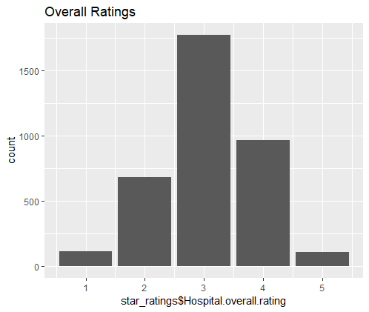
OVERALL RATINGS
RATINGS | NO_OF_PROVIDERS
1 | 117 (3.4%)
2 | 659 (19.5%)
3 | 1426 (42.2%)
4 | 749 (22.1%)
5 | 110 (3.3%)
Approx 42% providers have 3 star rating
Approx 20% providers have 2 and 4 star rating
Approx 3.4% providers have 1 and 5 star rating

Slide 8
Overview of Methodology
The methodology takes a five-step approach to calculating the Star Ratings
. The measures are first selected based on their relevance and importance as determined through stakeholder and expert feedback, and the included measures are standardized to be consistent in terms of direction and magnitude.
These standardized measures are then organized into seven groups according to measure type.
Third, for each group a latent variable model/Factor Analysis is used to estimate a group score for each hospital reporting measures in that group.
In the fourth step, a weight is applied to each group score, and all available groups are averaged to calculate the hospital summary score.
Finally, to assign a Star Rating, the hospital summary scores are organized into five ordered categories using a clustering algorithm.
In addition to the Star Ratings, CMS also organized hospitals into one of three group performance categories (above, same as, and below the national average) for each of the hospital’s available groups, providing additional detail for patients and consumers.

Slide 9
Weightage of Groups
Group | Star Ratings Weight
Mortality | 22%
Safety of Care | 22%
Readmission | 22%
Patient Experience | 22%
Effectiveness | 4%
Timeliness | 4%
Effecient use of Medical Imaging | 4%
CMS reports hospital performance at the group level, separately categorizing each of a hospital’s available group scores into one of three group performance categories (above, same as, and below the national average )

Slide 10
Group performance Category
In addition to a hospital’s Star Rating, CMS reports a group performance category for each of a hospital’s available (i.e., meeting the minimum threshold) measure groups. To calculate a performance category, a hospital’s group score is compared to the national average group score. The LVM for each group produces a point estimate and standard error that can be used to construct a 95% confidence interval for each hospital’s group score for comparison to the national mean group score. The group performance categories are:
“Above the national average,” defined as a group score with a confidence interval that falls entirely above the national average;
“Same as the national average,” defined as a group score with a confidence interval that includes the national average; and
“Below the national average,” defined as a group score with a confidence interval that falls entirely below the national average.

Slide 11
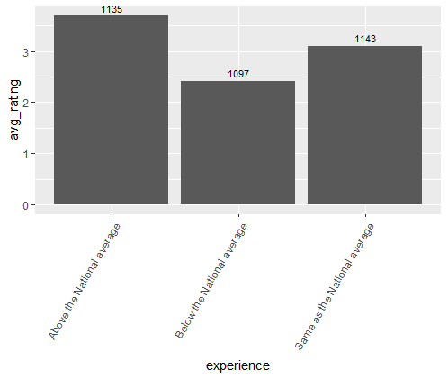
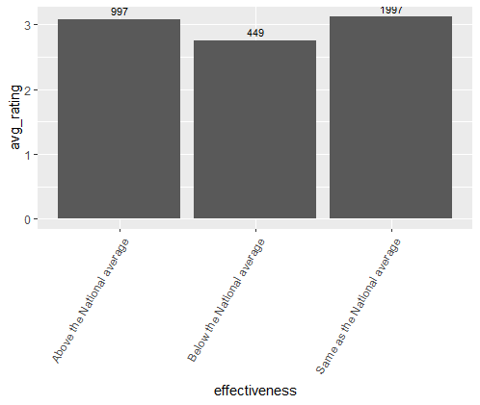
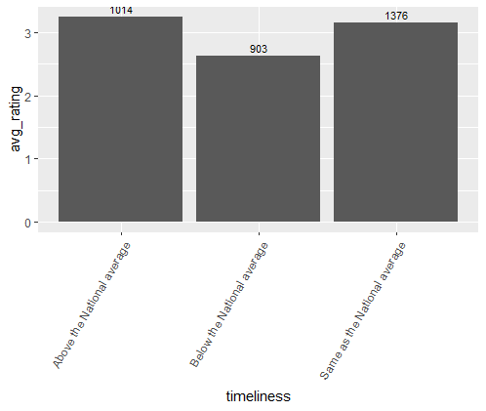
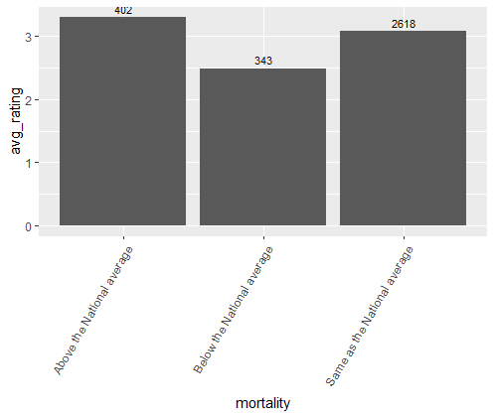
DISTRIBUTION OF AVG RATINGS ON GROUPS

Slide 12

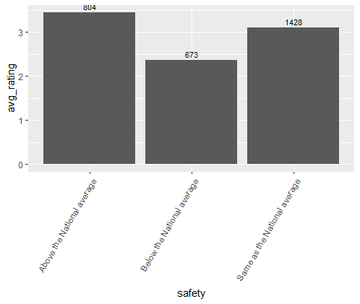
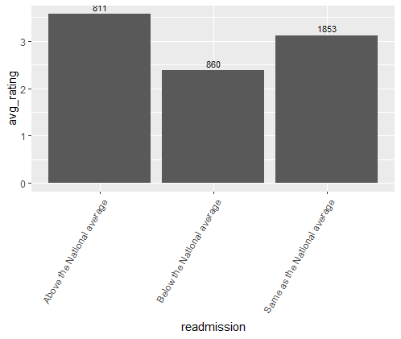
DISTRIBUTION OF AVG RATINGS ON GROUPS

Slide 13
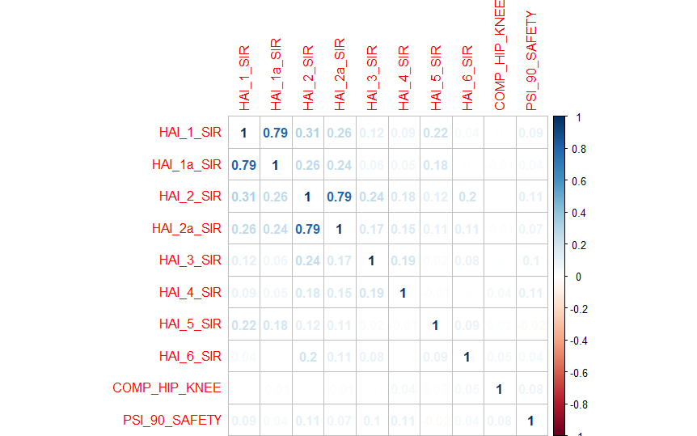
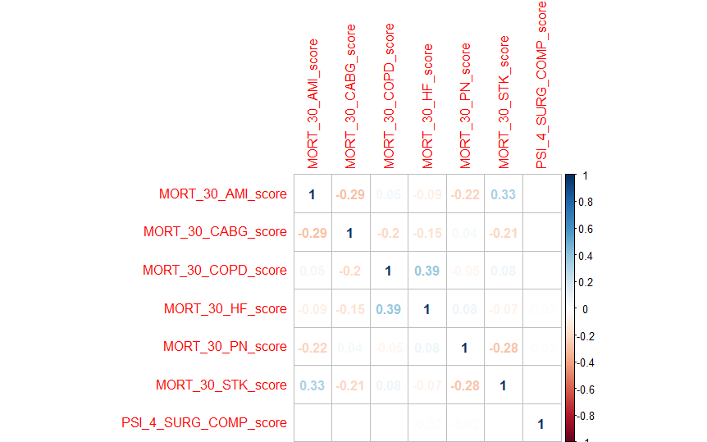
Measure Importance
Within each group, the correlation plots which signify the meaure importance
SAFETY
MORTALITY
HAI-1 Central-Line Associated Bloodstream Infection (CLABSI)
HAI-2 Catheter-Associated Urinary Tract Infection (CAUTI) HAI-3 Surgical Site Infection from colon surgery (SSI-colon
HAI-4 Surgical Site Infection from abdominal hysterectomy (SSI-abdominal hysterectomy)
HAI-5 MRSA Bacteremia
HAI-6 Clostridium Difficile (C. difficile)
PSI-90-Safety Complication/
MORT-30-AMI Acute Myocardial Infarction (AMI) 30-Day Mortality Rate
MORT-30-CABG Coronary Artery Bypass Graft (CABG) 30-Day Mortality Rate
MORT-30-COPD Chronic Obstructive Pulmonary Disease (COPD) 30-Day Mortality MORT-30-HF Heart Failure (HF) 30-Day Mortality Rate
MORT-30-PN Pneumonia (PN) 30-Day Mortality Rate
MORT-30-STK Acute Ischemic Stroke (STK) 30-Day Mortality Rate
PSI-4-SURG-COMP Death Among Surgical Patients with Serious Treatable Complications

Slide 14
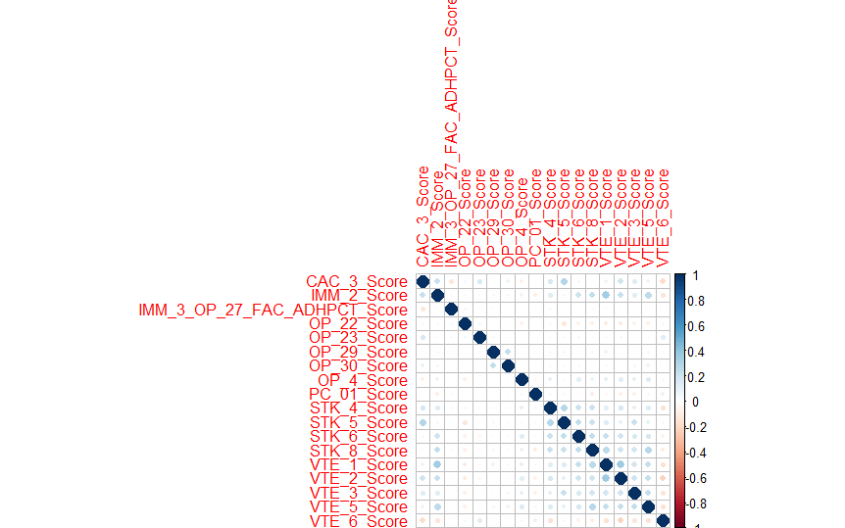
EFFECTIVENESS cor PLOT
CAC-3 Home Management Plan of Care (HMPC) Document Given to Patient/Caregiver
IMM-2 Influenza Immunization
IMM-3/OP-27 Healthcare Personnel Influenza Vaccination
OP-4 Aspirin at Arrival
OP-22 ED-Patient Left Without Being Seen
OP-23 ED-Head CT or MRI Scan Results for Acute Ischemic Stroke or Hemorrhagic Stroke who Received Head CT or MRI Scan Interpretation Within 45 Minutes of Arrival
OP-29 Endoscopy/Poly Surveillance-Appropriate Follow-up Interval for Normal Colonoscopy in Average Risk Patients
OP-30 Endoscopy/Poly Surveillance-OP-30: Endoscopy/Poly Surveillance – Colonoscopy Interval for Patients with a History of Adenomatous Polyps – Avoidance of Inappropriate Use
PC-01 Elective Delivery Prior to 39 Completed Weeks Gestation: Percentage of Babies Electively Delivered Prior to 39 Completed Weeks Gestation
STK-1 Venous Thromboembolism (VTE) Prophylaxis
STK-4 Thrombolytic Therapy
STK-6 Discharged on Statin Medication
STK-8 Stroke Education
VTE-1 Venous Thromboembolism Prophylaxis
VTE-2 Intensive Care Unit Venous Thromboembolism Prophylaxis
VTE-3 Venous Thromboembolism Patients with Anticoagulation Overlap Therapy
VTE-5 Venous Thromboembolism Warfarin Therapy Discharge Instructions
VTE-6 Hospital Acquired Potentially-Preventable Venous Thromboembolism

Slide 15
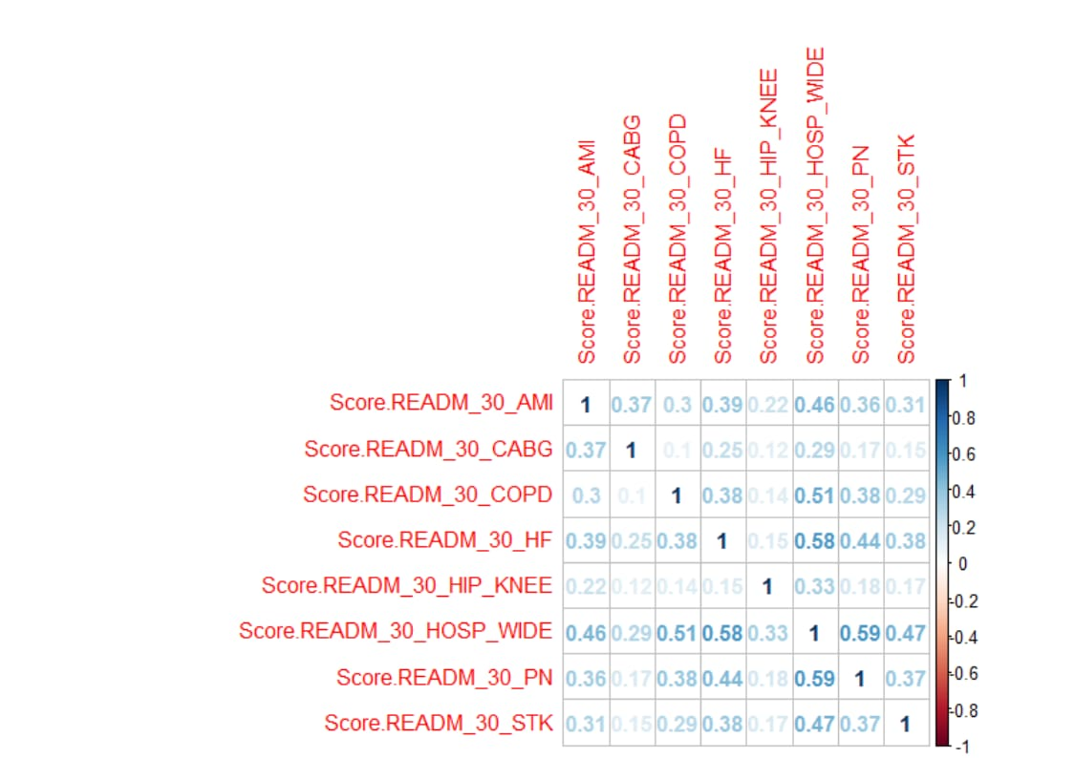
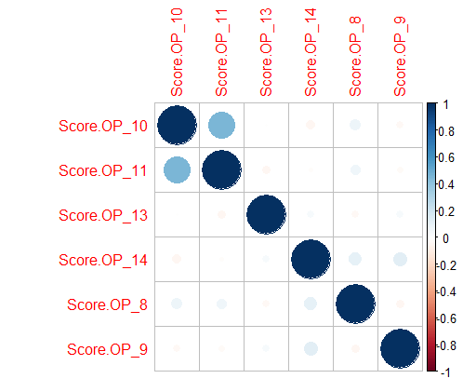
READMISSION
EFFECTIVE USE OF MEDICAL IMAGING
READM-30-AMI Acute Myocardial Infarction (AMI) 30-Day Readmission Rate
READM-30-CABG Coronary Artery Bypass Graft (CABG) 30-Day Readmission Rate
READM-30-COPD Chronic Obstructive Pulmonary Disease (COPD) 30-Day Readmission Rate
READM-30-HF Heart Failure (HF) 30-Day Readmission Rate
READM-30-Hip-Knee Hospital-Level 30-Day All-Cause Risk-Standardized Readmission Rate (RSRR) Following Elective Total Hip Arthroplasty (THA)/Total Knee Arthroplasty (TKA)
READM-30-HOSP-WIDE HWR Hospital-Wide All-Cause Unplanned Readmission
READM-30-PN Pneumonia (PN) 30-Day Readmission Rate
READM-30-STK Stroke (STK) 30-Day Readmission Rate
OP-8 MRI Lumbar Spine for Low Back Pain
OP-10 Abdomen CT Use of Contrast Material
OP-11 Thorax CT Use of Contrast Material
OP-13 Cardiac Imaging for Preoperative Risk Assessment for Non-Cardiac Low-Risk Surgery -
OP-14 Simultaneous Use of Brain Computed Tomography (CT) and Sinus CT

Slide 16
Data Modelling: Supervised Learning methods:
Naïve Bayes
It is a classification technique based on Bayes’ Theorem with an assumption of independence among predictors. In simple terms, a Naive Bayes classifier assumes that the presence of a particular feature in a class is unrelated to the presence of any other feature.
The reason that Naive Bayes algorithm is called Naive is not because it is simple. It is because the algorithm makes a very strong assumption about the data having features independent of each other while in reality, they may be dependent in some way.
If this assumption of independence holds, Naive Bayes performs extremely well and often better than other models. Naive Bayes can also be used with continuous features but is more suited to categorical variables. If all the input features are categorical, Naive Bayes is recommended. However, in case of numeric features, it makes another strong assumption which is that the numerical variable is normally distributed.
Here are some tehniques for improving power of Naive Bayes Model:
If continuous features do not have normal distribution, we should use transformation or different methods to convert it in normal distribution.
If test data set has zero frequency issue, apply smoothing techniques “Laplace Correction” to predict the class of test data set.Remove correlated features, as the highly correlated features are voted twice in the model and it can lead to over inflating importance.

Slide 17
Data Modelling: Supervised Learning methods:
Naïve Bayes
Pros:
It is easy and fast to predict class of test data set. It also performs well in multi class prediction
When assumption of independence holds, a Naive Bayes classifier performs better compare to other models like logistic regression and you need less training data.
It performs well in case of categorical input variables compared to numerical variable(s). For numerical variable, normal distribution is assumed (bell curve, which is a strong assumption).
Cons:
If categorical variable has a category (in test data set), which was not observed in training data set, then model will assign a 0 (zero) probability and will be unable to make a prediction. This is often known as “Zero Frequency”. To solve this, we can use the smoothing technique.
Another limitation of Naive Bayes is the assumption of independent predictors. In real life, it is almost impossible that we get a set of predictors which are completely independent.

Slide 18
Data Modelling: Supervised Learning methods:
2. Decision Trees
The major advantage of using decision trees is that they are intuitively very easy to explain. They closely mirror human decision-making compared to other regression and classification approaches. They can be displayed graphically, and they can easily handle qualitative predictors without the need to create dummy variables.
However, decision trees generally do not have the same level of predictive accuracy as other approaches, since they aren't quite robust. A small change in the data can cause a large change in the final estimated tree.
By aggregating many decision trees, using methods like bagging, random forests, and boosting, the predictive performance of decision trees can be substantially improved.
2.1 Bagging
The decision trees suffer from high variance, meaning if you split the training data into 2 parts at random, and fit a decision tree to both halves, the results that you get could be quite different. In contrast, a procedure with low variance will yield similar results if applied repeatedly to distinct dataset.
Bagging, or bootstrap aggregation, is a technique used to reduce the variance of your predictions by combining the result of multiple classifiers modeled on different sub-samples of the same dataset.
in which you generate B different bootstrapped training datasets. You then train your method on the bth bootstrapped training set in order to get f^b(x), and finally average the predictions.

Slide 19
Data Modelling: Supervised Learning methods:
2.1 Bagging
Pros
Reduces variance in comparison to regular decision trees
Can provide variable importance measures
Can easily handle qualitative (categorical) features
Out of bag (OOB) estimates can be used for model validation
Cons
Not as easy to visually interpret
Does not reduce variance if the features are correlated

Slide 20
Data Modelling: Supervised Learning methods:
2.2 Random Forests
Random Forests is a versatile machine learning method capable of performing both regression and classification tasks. It also undertakes dimensional reduction methods, treats missing values, outlier values and other essential steps of data exploration, and does a fairly good job.
Random Forests provides an improvement over bagged trees by a small tweak that decorrelates the trees. As in bagging, you build a number of decision trees on bootstrapped training samples. But when building these decision trees, each time a split in a tree is considered, a random sample of m predictors is chosen as split candidates from the full set of p predictors. The split is allowed to use only one of those m predictors. This is the main difference between random forests and bagging; because as in bagging, the choice of predictor m=p.
Random Forests is very effective at estimating missing data and maintaining accuracy when a large proportion of the data is missing. It can also balance errors in datasets where the classes are imbalanced. Most importantly, it can handle massive datasets with large dimensionality. However, one disadvantage of using Random Forests is that you might easily overfit noisy datasets, especially in the case of doing regression

Slide 21
Data Modelling: Supervised Learning methods:
3. SVM:
“Support Vector Machine” (SVM) is a supervised machine learning algorithm which can be used for both classification or regression challenges. However, it is mostly used in classification problems. In this algorithm, we plot each data item as a point in n-dimensional space (where n is number of features you have) with the value of each feature being the value of a particular coordinate. Then, we perform classification by finding the hyper-plane that differentiate the two classes very well
Advantages
High Dimensionality: SVM is an effective tool in high-dimensional spaces, which is particularly applicable to document classification and sentiment analysis where the dimensionality can be extremely large.
Memory Efficiency: Since only a subset of the training points are used in the actual decision process of assigning new members, just these points need to be stored in memory (and calculated upon) when making decisions.
Versatility: Class separation is often highly non-linear. The ability to apply new kernels allows substantial flexibility for the decision boundaries, leading to greater classification performance.

Slide 22
Data Modelling: Supervised Learning methods:
3. SVM:
Disadvantages
Kernel Parameters Selection: SVMs are very sensitive to the choice of the kernel parameters. In situations where the number of features for each object exceeds the number of training data samples, SVMs can perform poorly. This can be seen intuitively as if the high-dimensional feature space is much larger than the samples. Then there are less effective support vectors on which to support the optimal linear hyperplanes, leading to poorer classification performance as new unseen samples are added.
Non-Probabilistic: Since the classifier works by placing objects above and below a classifying hyperplane, there is no direct probabilistic interpretation for group membership. However, one potential metric to determine the "effectiveness" of the classification is how far from the decision boundary the new point is.
Time Consumed: When compared with other machine learning algorithms for the same problem, SVMs consume a lot of time.
For hospital rating problem, we use Random Forests to classify the hospitals into 5 categories each representing one of the ratings (1-5).

Slide 23
Data Modelling: UnSupervised Learning methods:
KNN
Approach for Translating a Summary Score to a Star Rating
To translate each hospital’s summary score to a rating between one and five stars, CMS applies k-means clustering.
Overview of k-Means Clustering
The k-means clustering analysis is a standard method for creating categories (or clusters) so that observations in each category are closer to their category mean than to any other category mean. The number of categories is pre-specified; CMS specifies five categories, so that k-means clustering analysis generates five categories (clusters) based on hospital summary scores in a way that minimizes the distance between summary scores (observations) and the middle value of their assigned cluster (category mean). It organizes hospitals into one of five categories such that a hospital’s summary score is “more like” that of the other hospitals in the same category and “less like” the summary scores of hospitals in the other categories. The Star Rating categories are structured such that the lowest group is one star and the highest group is five stars.

Slide 24
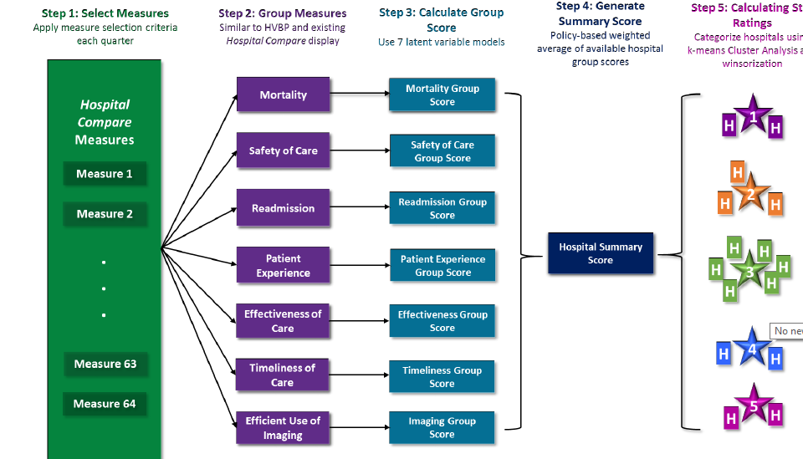
Process
• Using the measure weights calculated using factor analysis, each group’s score is calculated
• The group scores are multiplied by the weight of group (22% or 4%) to calculate the final score
• Based on the final score, 5 clusters are created

